Slide 1
Nash Equilibria and Network Traffic

Slide 2
Nash Equilibria

Slide 3
Recap: Normal-Form Games
Normal-form game: Players, strategies, outcomes, payoff functions, payoff matrices. Assumptions for games.
Dominant strategies:
Best responses and strict best responses.
Dominant strategies and strictly dominant strategies.
Reasoning about behavior in a game:
Both players have strictly dominant strategies.
Only one player has a strictly dominant strategy.
Neither of the players has a strictly dominant strategy.

Slide 4
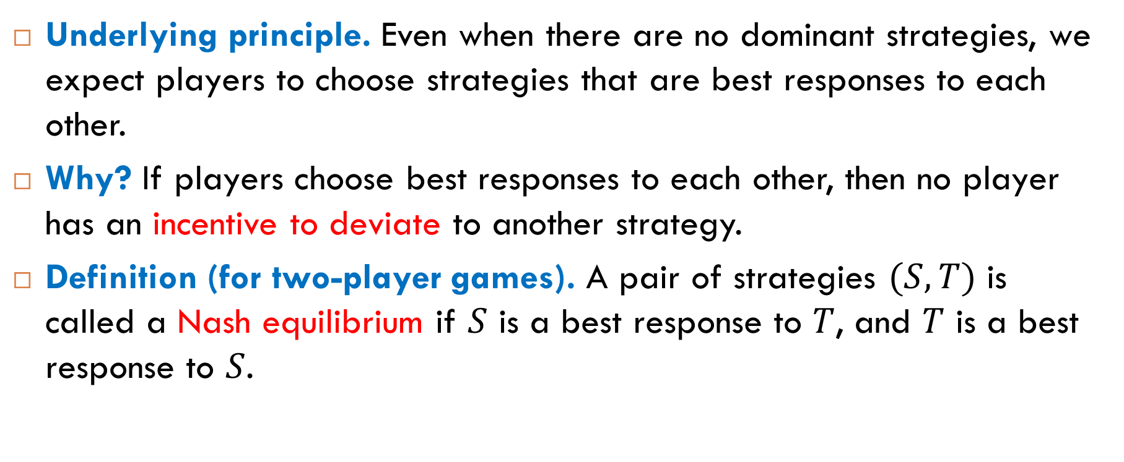
Idea of Nash Equilibrium
Underlying principle. Even when there are no dominant strategies, we expect players to choose strategies that are best responses to each other.
Why? If players choose best responses to each other, then no player has an incentive to deviate to another strategy.
Definition (for two-player games). A pair of strategies $(S,T)$ is called a Nash equilibrium if $S$ is a best response to $T$, and $T$ is a best response to $S$.

Slide 5
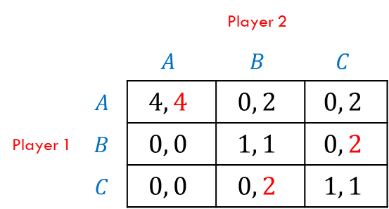
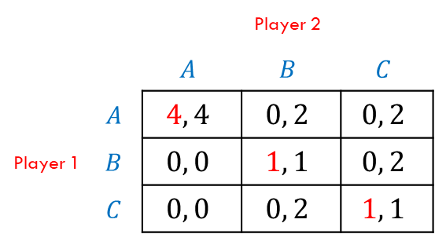
Finding Nash Equilibrium: Step 1
 |  | Player 2
 |  | $$A$$ | $$B$$ | $$C$$
Player 1 | $$A$$ | $$4, 4$$ | $$0, 2$$ | $$0, 2$$
 | $$B$$ | $$0, 0$$ | $$1, 1$$ | $$0, 2$$
 | $$C$$ | $$0, 0$$ | $$0, 2$$ | $$1, 1$$
For Player 1, find the best responses to each strategy of Player 2.
 |  | Player 2
 |  | $$A$$ | $$B$$ | $$C$$
Player 1 | $$A$$ | $$4, 4$$ | $$0, 2$$ | $$0, 2$$
 | $$B$$ | $$0, 0$$ | $$1, 1$$ | $$0, 2$$
 | $$C$$ | $$0, 0$$ | $$0, 2$$ | $$1, 1$$
For Player 2, find the best responses to each strategy of Player 1.

Slide 6


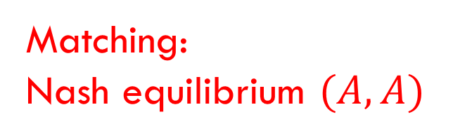
Finding Nash Equilibrium: Step 2
 |  | Player 2
 |  | $$A$$ | $$B$$ | $$C$$
Player 1 | $$A$$ | $$4, 4$$ | $$0, 2$$ | $$0, 2$$
 | $$B$$ | $$0, 0$$ | $$1, 1$$ | $$0, 2$$
 | $$C$$ | $$0, 0$$ | $$0, 2$$ | $$1, 1$$
Matching:
Nash equilibrium $(A,A)$
 |  | Player 2
 |  | $$A$$ | $$B$$ | $$C$$
Player 1 | $$A$$ | $$4, 4$$ | $$0, 2$$ | $$0, 2$$
 | $$B$$ | $$0, 0$$ | $$1, 1$$ | $$0, 2$$
 | $$C$$ | $$0, 0$$ | $$0, 2$$ | $$1, 1$$

Slide 7
Single Nash Equilibrium
Assumption. If a game has a single Nash equilibrium, we assume that all players choose strategies in this equilibrium.
Multiple Nash equilibrium
Are there games with more than one Nash equilibrium?
Yes. A typical example of such games is a coordination game. In this case it is difficult to predict how players will behave in the game.

Slide 8
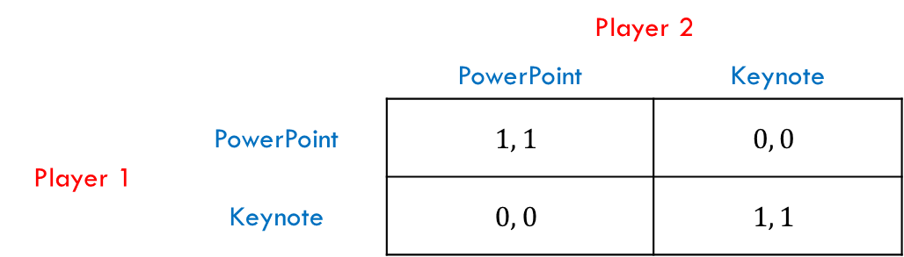
Coordination Games: Example 1
You prepare slides for a joint presentation with a partner and you need to choose a tool: PowerPoint or Apple’s Keynote. Your partner is in the same situation, and you cannot contact each other. What is your choice?
There are two Nash equilibria in coordination games: (PowerPoint, PowerPoint) and (Keynote, Keynote).

Slide 9
Coordination Games: Example 2
Two drivers meet on a narrow road. Both have to swerve in order to avoid a head-on collision. If both swerve to different sides they will manage to pass each other, but if they choose the same side they will collide. What strategy to choose: “left” or “right”?
Social conventions
USA: move to the right
England: move to the left

Slide 10
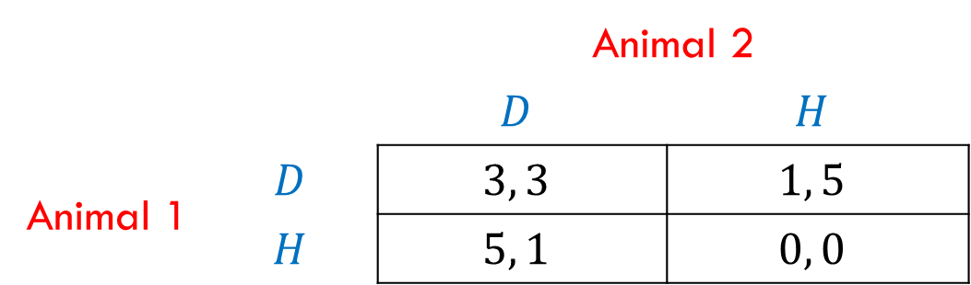

Example 3: The Hawk-Dove Game
Two animals divide a piece of food between them. Each animal can choose to behave aggressively (the Hawk strategy) or passively (the Dove strategy). Are there Nash equilibria?
This game has two Nash equilibria: $(D, H)$and $(H, D).$
 |  | Animal 2
 |  | $$D$$ | $$H$$
Animal 1 | $$D$$ | $$3, 3$$ | $$1, 5$$
 | $$H$$ | $$5, 1$$ | $$0, 0$$

Slide 11
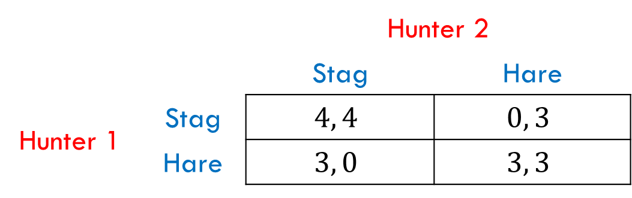

Example 4: The Stag-Hunt Game
Two people are hunting. If they work together, they can catch a stag, but on their own each can catch a hare. Are there Nash equilibria?
This game has two Nash equilibria: $($Stag, Stag$)$and $($Hare, Hare$).$

Slide 12
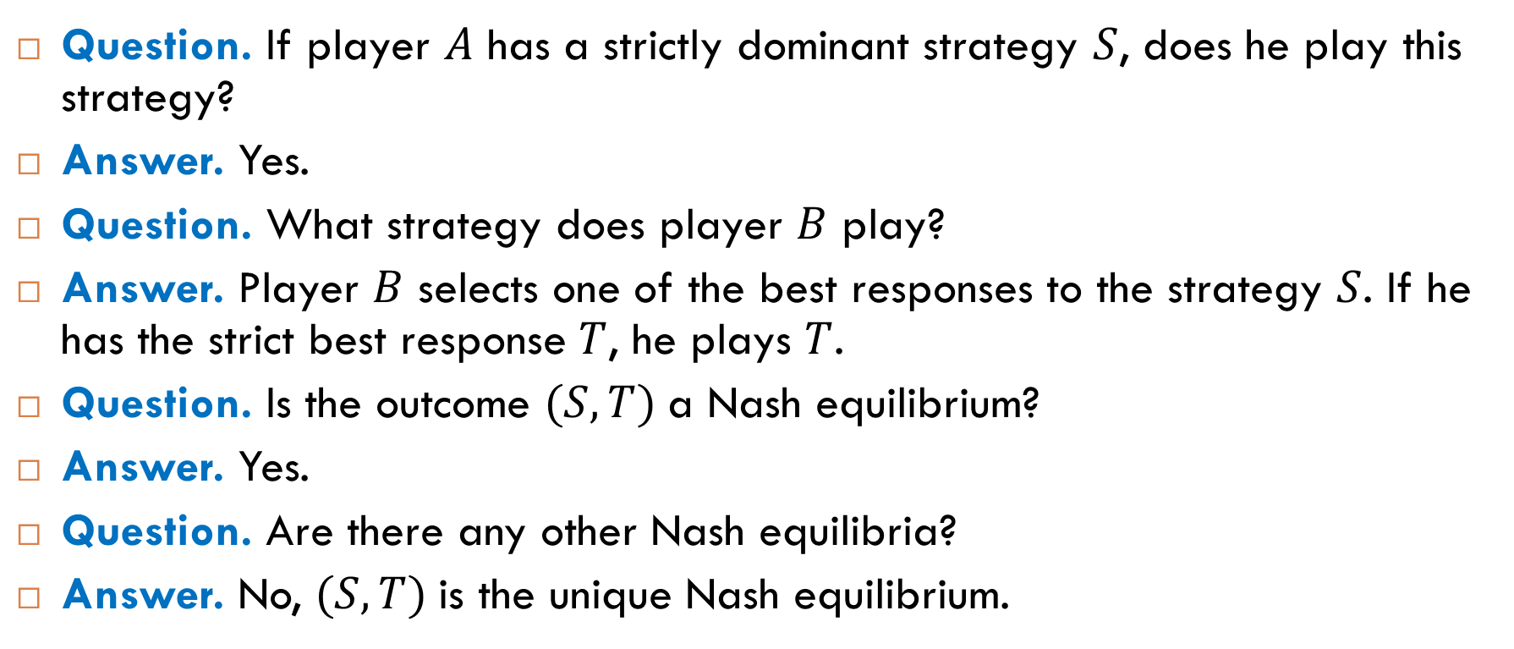
Behavior of Two Players
Question. If player $A$ has a strictly dominant strategy $S$, does he play this strategy?
Answer. Yes.
Question. What strategy does player $B$ play?
Answer. Player $B$ selects one of the best responses to the strategy $S$. If he has the strict best response $T$, he plays $T$.
Question. Is the outcome $(S, T)$a Nash equilibrium?
Answer. Yes.
Question. Are there any other Nash equilibria?
Answer. No, $(S, T)$is the unique Nash equilibrium.

Slide 13
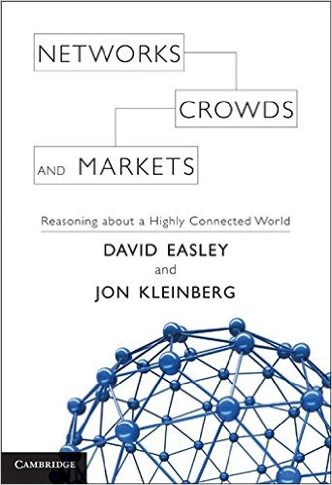
Reading
Section 6.4

Slide 14
Modeling Network Traffic

Slide 15
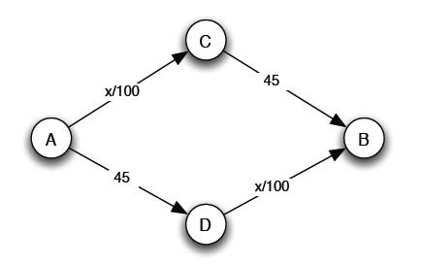
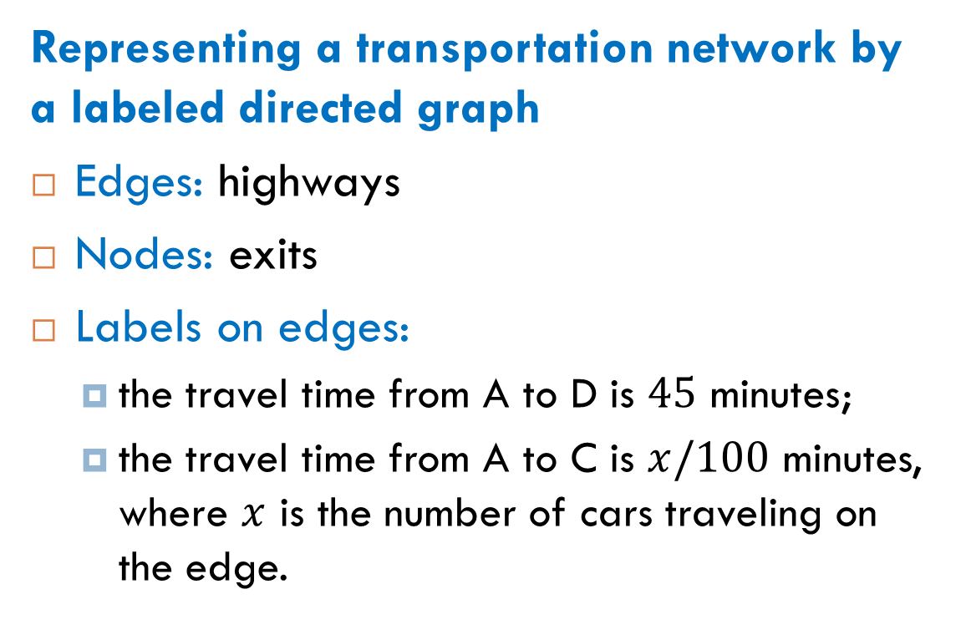
Transportation Networks: Example
Representing a transportation network by a labeled directed graph
Edges: highways
Nodes: exits
Labels on edges:
the travel time from A to D is $45$ minutes;
the travel time from A to C is $x/100$ minutes, where $x$ is the number of cars traveling on the edge.

Slide 16

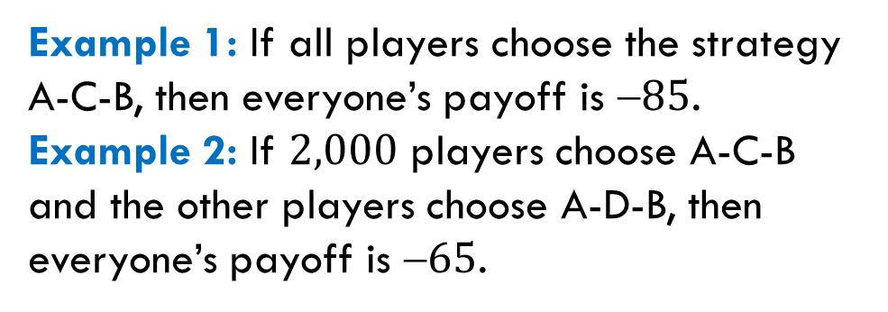
Traffic: Example
Number of players: $4,000$
Strategies for each player: A-C-B and A-D-B
Payoff: $$(the total travel time)
Example 1: If all players choose the strategy A-C-B, then everyone’s payoff is $85$.
Example 2: If $2,000$ players choose A-C-B and the other players choose A-D-B, then everyone’s payoff is $65$.

Slide 17
Dominant Strategies
Question: Does a player have a dominant strategy?
Answer: No. For example, A-C-B cannot be a dominant strategy for a player because A-D-B would be the best choice if all other players are using A-C-B.

Slide 18
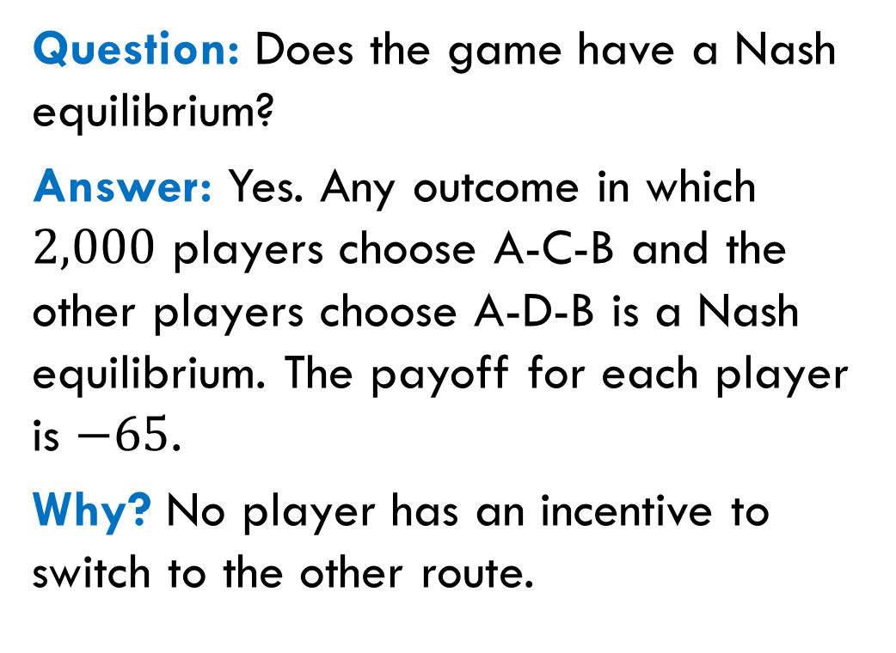
Nash Equilibria
Question: Does the game have a Nash equilibrium?
Answer: Yes. Any outcome in which $2,000$ players choose A-C-B and the other players choose A-D-B is a Nash equilibrium. The payoff for each player is $−65$.
Why? No player has an incentive to switch to the other route.

Slide 19
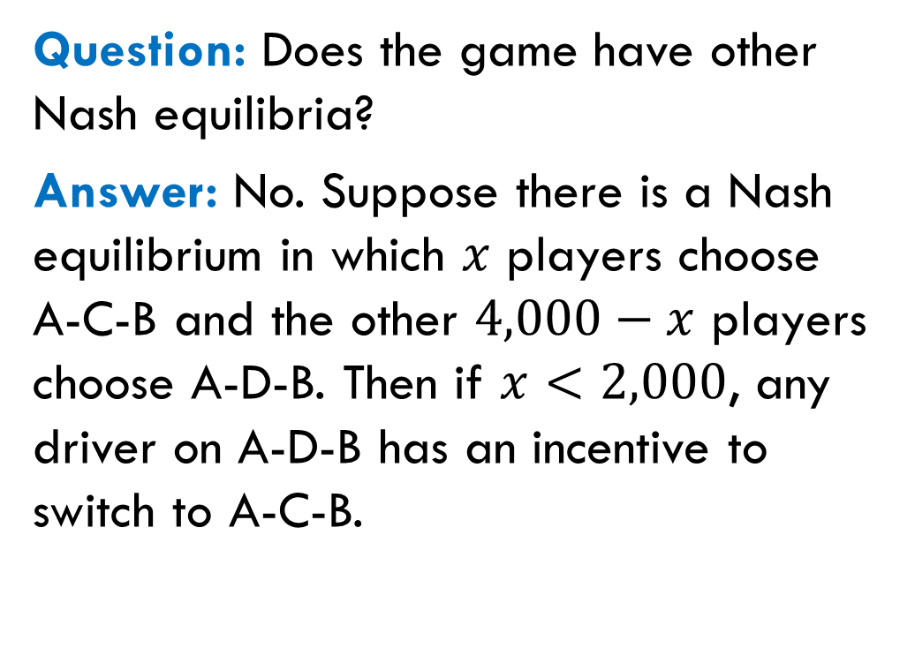
Other Nash Equilibria
Question: Does the game have other Nash equilibria?
Answer: No. Suppose there is a Nash equilibrium in which $x$ players choose A-C-B and the other $4,000−x$ players choose A-D-B. Then if $x<2,000$, any driver on A-D-B has an incentive to switch to A-C-B.

Slide 20
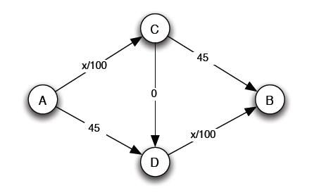
New Highway
It is planned to build a new highway (to decrease the traffic):
Question: Does the new game have a Nash equilibrium?
new highway

Slide 21
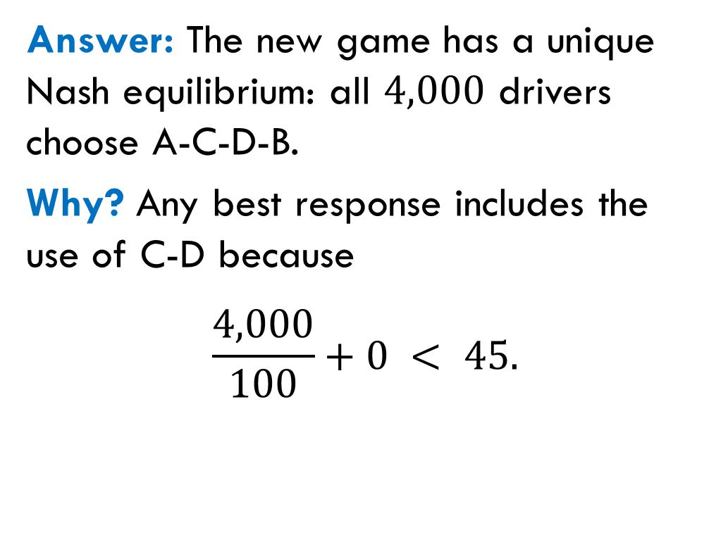
New Highway: Nash Equilibrium
Answer: The new game has a unique Nash equilibrium: all $4,000$ drivers choose A-C-D-B.
Why? Any best response includes the use of C-D because
$$\frac{4,000}{100}+0 < 45.$$

Slide 22
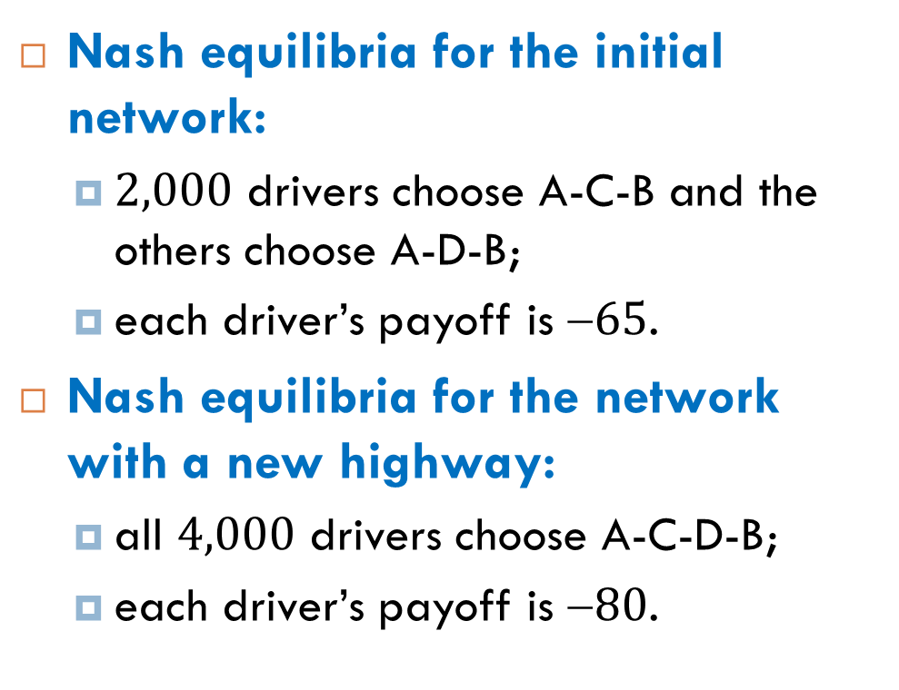
Braess’s Paradox
Nash equilibria for the initial network:
$2,000$ drivers choose A-C-B and the others choose A-D-B;
each driver’s payoff is $65$.
Nash equilibria for the network with a new highway:
all $4,000$ drivers choose A-C-D-B;
each driver’s payoff is $80$.

Slide 23
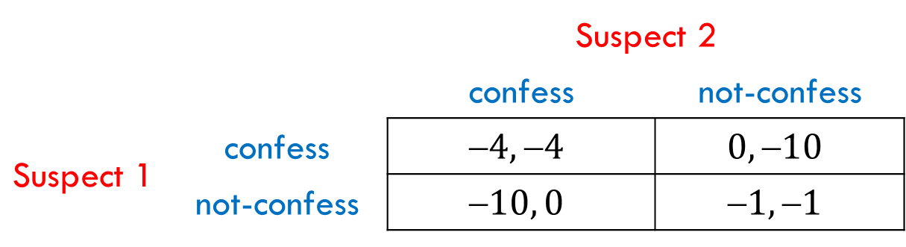

Is It Surprising?
We have already seen a game where adding a new strategy makes things worse for everyone.
If each player had the only strategy “not-confess”, the payoff for each would be $1$ (instead of $4$ in the case of two strategies).
 |  | Suspect 2
 |  | confess | not-confess
Suspect 1 | confess | $$4, 4$$ | $$0, 10$$
 | not-confess | $$10, 0$$ | $$1, 1$$

Slide 24
Reading
Sections 8.1-8.2

Slide 25
No Nash Equilibrium

Slide 26
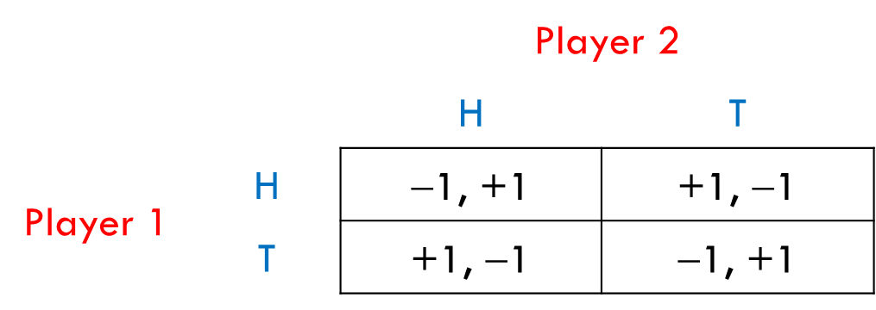
Example: Matching-Coin Game
Two people each have a coin and simultaneously choose whether to show heads or tails on their coins. If they match, then Player 1 gives his coin to Player 2. Otherwise, Player 2 gives his coin to Player 1.
There is no Nash equilibrium in this game.

Slide 27
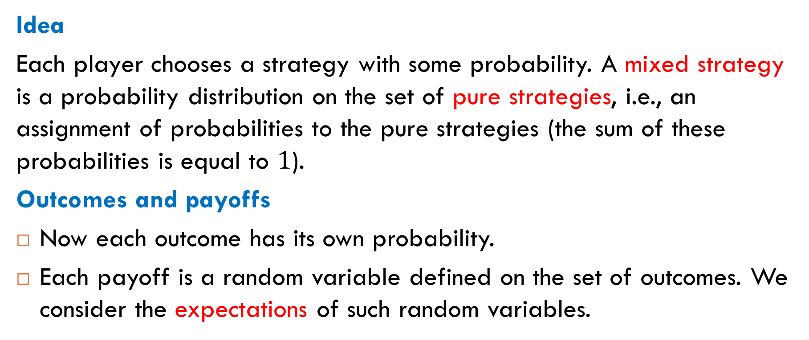
Idea of Mixed Strategies
Idea
Each player chooses a strategy with some probability. A mixed strategy is a probability distribution on the set of pure strategies, i.e., an assignment of probabilities to the pure strategies (the sum of these probabilities is equal to $1$).
Outcomes and payoffs
Now each outcome has its own probability.
Each payoff is a random variable defined on the set of outcomes. We consider the expectations of such random variables.

Slide 28
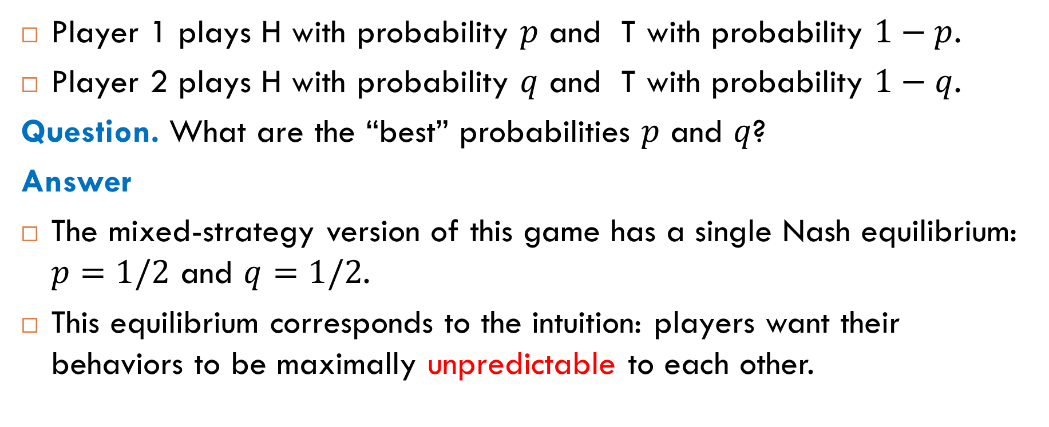
Example: Matching-Coin Game
Player 1 plays H with probability $p$ and T with probability $1−p$.
Player 2 plays H with probability $q$ and T with probability $1−q$.
Question. What are the “best” probabilities $p$ and $q$?
Answer
The mixed-strategy version of this game has a single Nash equilibrium: $p=1/2$ and $q=1/2$.
This equilibrium corresponds to the intuition: players want their behaviors to be maximally unpredictable to each other.

Slide 29
Nash Equilibria of Mixed Strategies
Theorem (Nash, 1951). Any mixed-strategy game with a finite number of players and a finite number of pure strategies for each player has at least one Nash equilibrium of mixed strategies.
Theorem (von Neumann, 1928). In any Nash equilibrium, each player receives a payoff that is equal to both his maximin value and his minimax value.
Maximin: The maximin strategy of a player maximizes his worst-case (minimum) payoff.
Minimax: The minimax strategy of a player minimizes the best-case (maximum) payoff of the opponent.

Slide 30
Penalty-Kick Game (Soccer)
There is no Nash equilibrium for pure strategies. What is a Nash equilibrium for mixed strategies?
 |  | Goalie
 |  | dives left | dives right
Kicker | aims left | 0.58, −0.58 | 0.95, −0.95
 | aims right | 0.93, −0.93 | 0.70, −0.70

Slide 31
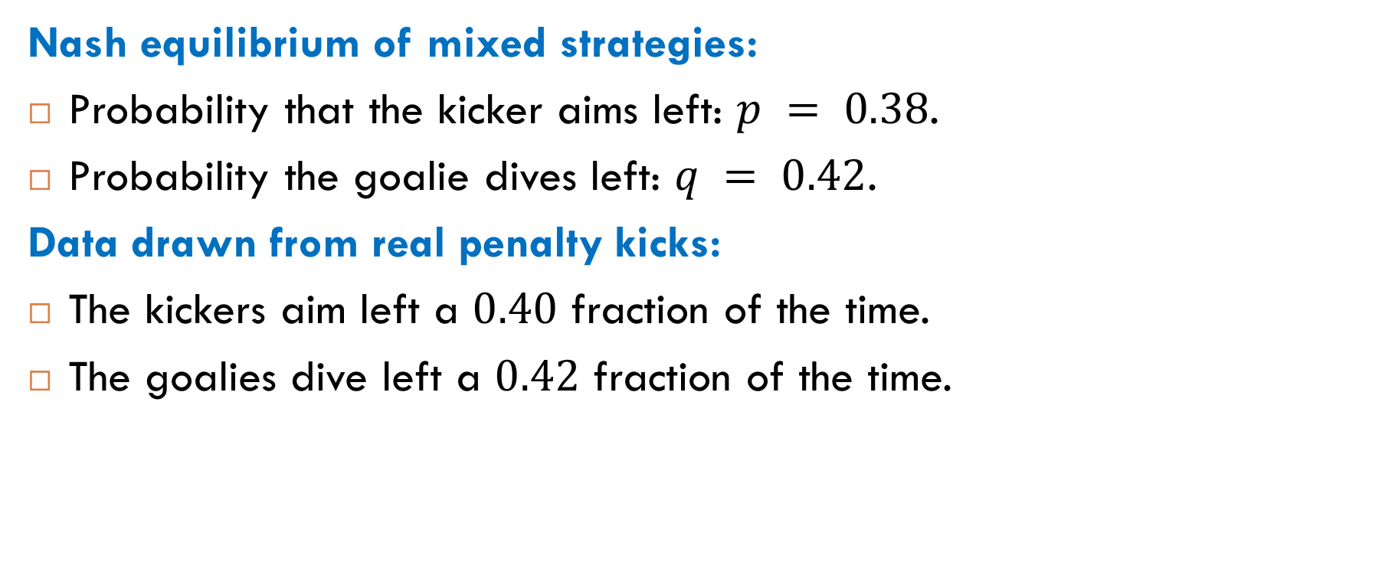
Penalty-Kick Game (Soccer)
Nash equilibrium of mixed strategies:
Probability that the kicker aims left: $p = 0.38$.
Probability the goalie dives left: $q = 0.42$.
Data drawn from real penalty kicks:
The kickers aim left a $0.40$ fraction of the time.
The goalies dive left a $0.42$ fraction of the time.

